Slide 1
COMPANY OVERVIEW
Our Services
Your Trusted Atlanta CPA Firm
WWW.CKHGROUP.COM

Slide 2
OVERVIEW
PRESENTATION OUTLINE
Meet the Team
Our Purpose
About CKH Group
CKH Group Service Solutions
Why CKH Group
Our Core Values
Testimonials
Contact

Slide 3
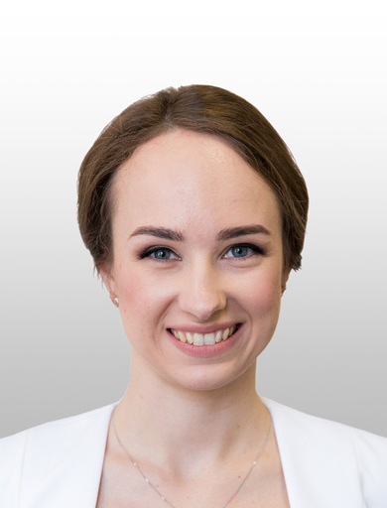
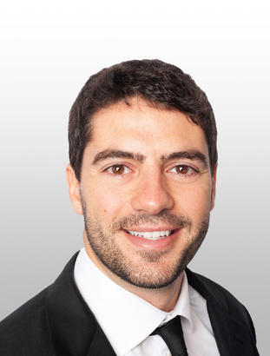
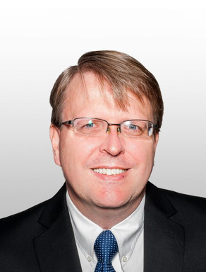
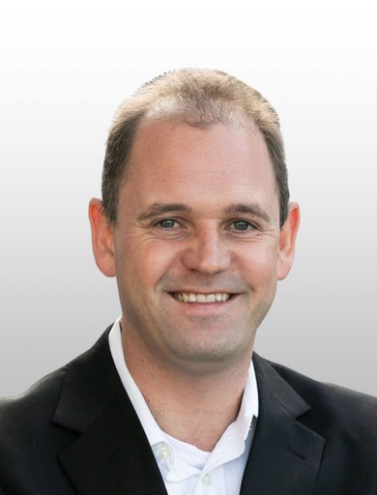
MEET THE TEAM
Kate Kudrenko
Nick Catrakilis Esq.
CPA, GROUP CEO
EXECUTIVE CHAIRMAN
Carve out financial statements
Corporate and indirect tax
Statutory Compliance (EMEA)
Legal Expertise
Assessment Specialist
VAT Compliance
Central Bank Exposure
Legal Due Diligence
Frank D’Urban Jackson
Eon van Wyk
CPA, CHIEF TAX OFFICER
CPA, CHIEF FINANCIAL OFFICER
Tax Planning & Compliance
Tax Accounting
Payroll Services
Wealth Management
Statutory Compliance EMEA focus
Head of audit US clients
US GAAP to local GAAP conversion (GAAP and IFRS experience)
Tax accounting

Slide 4
OUR PURPOSE
.
WE TAKE YOUR BUSINESS PERSONALLY
That's why we return your calls, respond to your concerns, and celebrate your wins- just like we have for our clients for over 20 years.
CKH Group’s mission is to provide our communities and financial leaders with quality accounting support, made accessible by our international resources and local expertise. Through our client-first partnership, we simplify compliance and take accountability for your financial success.
Every interaction with CKH Group is a blend of our 20+ years of local expertise with the scalability of our global network of support, a partnership that feels personal, and a commitment to simplifying the complexities of assurance, tax, and accounting. We take on your financial challenges as our own: your success is our goal.

Slide 5
ABOUT CKH GROUP
Poznań, Poland
LOCAL EXPERTISE BACKED BY GLOBAL SUPPORT
Atlanta-based headquarters with offices across the globe to provide big firm capabilities with a boutique, client-first approach.
HQ: Atlanta, Georgia
Kyiv, Ukraine
Hawkinsville, Georgia
Baku, Azerbaijan
Barcelona, Spain
Athens, Greece
Cape Town,
South Africa
Around the clock support
Servicing Fortune 1000 companies
CPA LED:
10+ CPAS/CAs ON STAFF
Servicing companies in 22 countries
2000+
200+
8
22
clients
employees
locations
languages
firm network
countries
250
100

Slide 6
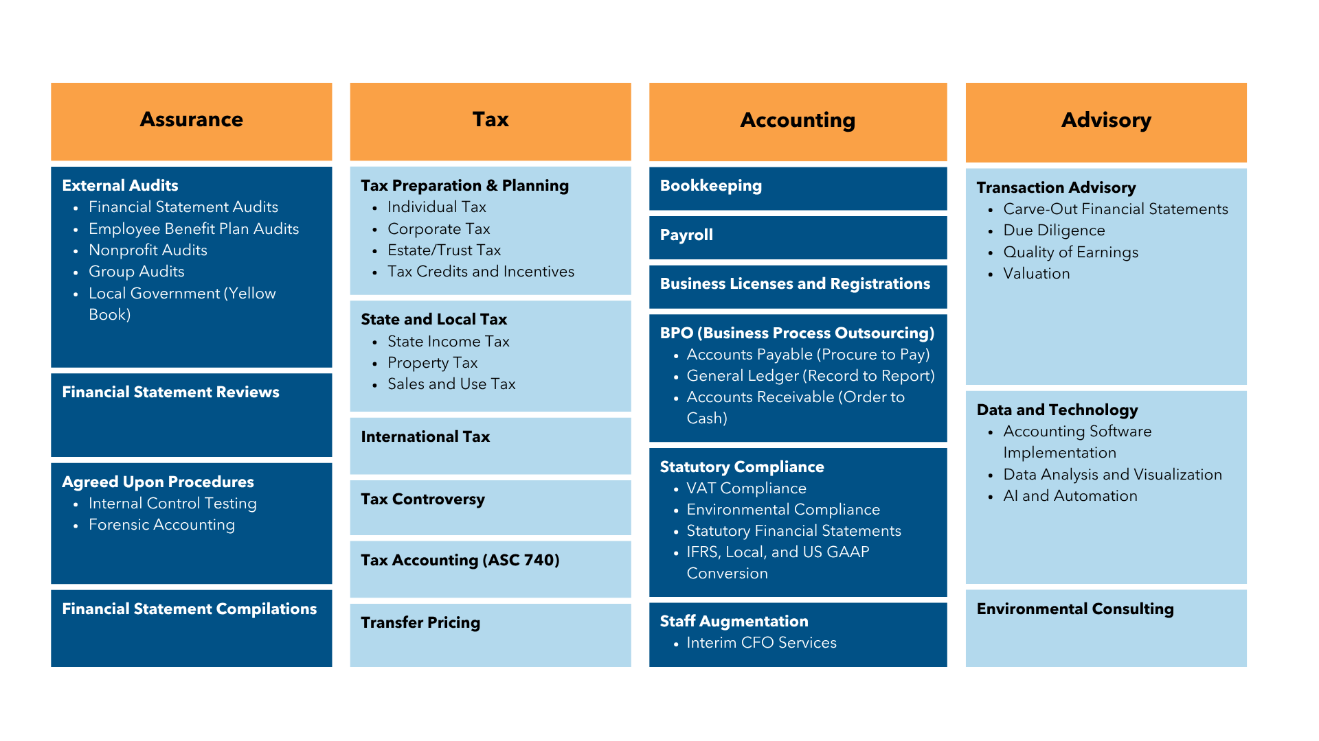
CKH GROUP SERVICE SOLUTIONS

Slide 7
WHY CKH GROUP?
#1 spot!
CLIENT-FIRST PARTNERSHIP
We take our client’s needs seriously, first and foremost. This is why we’ve tailored our business model around responsiveness and customized support for our clients. Watching clients grow alongside us is the cornerstone of why we do what we do. With CKH Group partnerships, we’re not just a service provider; we’re a long-term partner committed to your enduring success.
CPA-LED APPROACH
Our CPA-led model puts your business needs in the hands of seasoned experts who prioritize accuracy and reliability, granting you the peace of mind to focus on what truly matters: your success. Having a large number of CPAs in key leadership positions means our entire team can benefit from their knowledge in order to perform more complex accounting projects.
LOCAL EXPERTISE BACKED BY GLOBAL SUPPORT
Experience the CKH Group advantage: dedicated local support from our headquarters in Atlanta, Georgia, backed by the around-the-clock support from our global network of international offices with nearly 200 dedicated professionals. Our innovative business model prioritizes flexibility, communication, and consistent support, giving you the attentiveness you deserve.

Slide 8
OUR CORE VALUES
REACH HIGHER
.
NEVER STOP GROWING
SHAKE THE TREE
SUPPORT YOUR TEAM
ALWAYS STAY GROUNDED

Slide 9
WHAT ARE OUR CLIENTS SAYING ABOUT US?
I thoroughly appreciate the quality of service I receive from CKH. The firm exemplifies what I look for in a partner/service provider; they consistently under-sale and over-deliver. I couldn’t recommend CKH more highly.
I thoroughly appreciate the quality of service I receive from CKH. The firm exemplifies what I look for in a partner/service provider; they consistently under-sale and over-deliver. I couldn’t recommend CKH more highly.
Indirect Senior Tax Manager
Indirect Senior Tax Manager
Major Global Fortune 500 Company
Major Global Fortune 500 Company
CLIENT
TESTIMONIALS
We engaged the CKH team to assist us with an extremely complex accounting project. They overcame innumerable obstacles and hardships to make it happen. You are accounting warriors.
We engaged the CKH team to assist us with an extremely complex accounting project. They overcame innumerable obstacles and hardships to make it happen. You are accounting warriors.
Group Global Controller
Group Global Controller
Major Global FMCG Corporation
Major Global FMCG Corporation
The CKH audit team had an in-depth knowledge and the capability in delivering the audits in extremely tight schedules, without compromising quality. They provided in-depth knowledge and a focused approach to provide the right solutions to complicated accounting issues.
The CKH audit team had an in-depth knowledge and the capability in delivering the audits in extremely tight schedules, without compromising quality. They provided in-depth knowledge and a focused approach to provide the right solutions to complicated accounting issues.
Controller Major Markets
International IT Solutions Corporation
Controller Major Markets
International IT Solutions Corporation

Slide 10
CONTACT INFORMATION
Phone Number
1-770-495-9077
Email Address
info@ckhgroup.com
We aim to provide the greatest value
through the best experience.
Website
www.ckhgroup.com
ckh_group
CKH Group
CKH Group

